Slide 1
Aircraft Safety Analysis for Mawingu Group of Companies By Florence Joy Aran
Evaluating Low-Risk Aircrafts for Commercial and Private Operations

Slide 2
Summary
Analysis of historical data from the National Transportation and Safety Board on aviation accidents from 1962 to 2023 has outlined the necessities of identifying low risk aircrafts by:
Purchasing aircrafts with proven records of safety from manufacturers with proven track record of safety.
Choosing engine types that are proven to be safe.
Choosing planes with strong structural integrity.

Slide 3
Outline
Project overview
Business problem
Data understanding and cleaning
Data visualizations
Conclusion & Recommendation

Slide 4
Business Problem
Understanding Risks: Purchasing and operating aircraft involves safety, financial, and reputational risks.
Aircraft Selection: Choosing models with strong safety records is crucial for both commercial and private operations.
Data-Driven Decisions: Analyzing historical accident data helps identify trends, patterns, and risk factors.
Business Impact: Prioritizing safe aircraft enhances customer trust, financial stability, and brand reputation.

Slide 5
Data understanding and cleaning
Data from the National Transportation Safety Board on aviation accidents and incidents that occurred in the United States and other countries from 1962 to 2023
Includes fatalities, aircraft categories, aircraft damage, make and engine type etc.

Slide 6
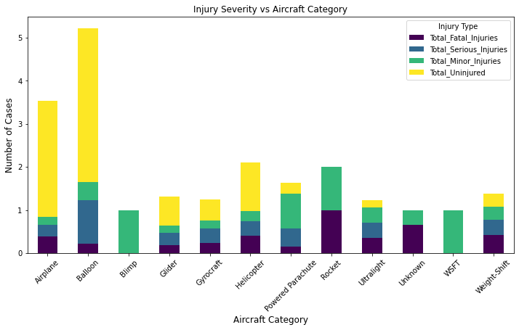
Data visualizations
Most aircrafts that got involved in accidents had fairly more uninjured people compared to total fatalities.
Blimp and WSFT only had minor injury cases and registered no fatalities

Slide 7
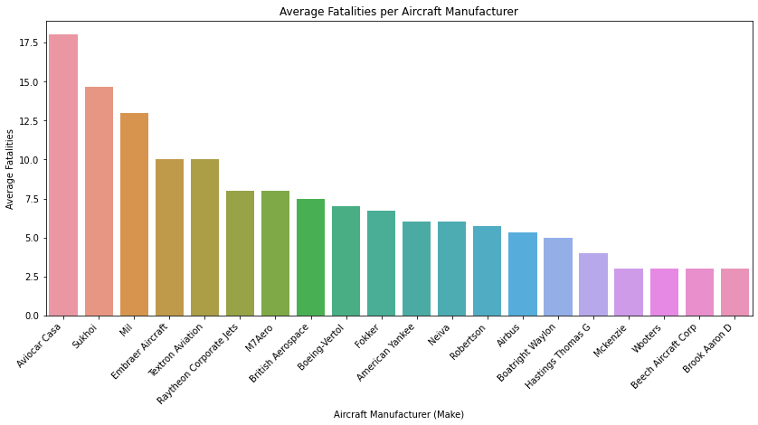
Manufacturers like Aviocar Casa have a history of higher average fatalities compared to other Makes.
Manufacturers with lower or zero fatalities are the best option for our needs

Slide 8
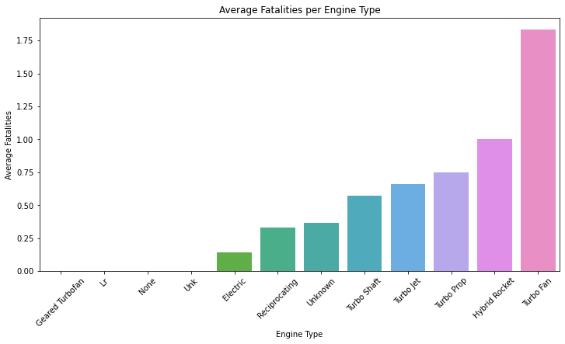
Turbo fan engines have higher fatalities compared to geared turbofan which has no known fatalities.

Slide 9
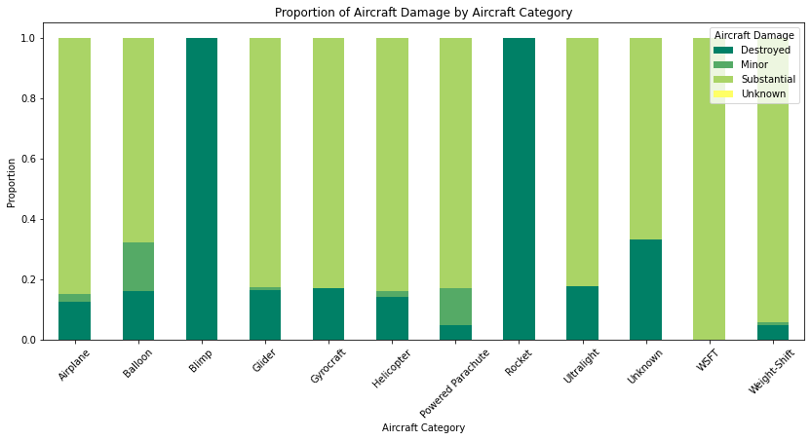
Aircrafts like the WSFT with only substantial amount of damage in accidents due to strong structural integrity may have fewer fatalities than others.

Slide 10
Conclusion
Ultimately, penetrating into the aviation industry requires selecting the right aircrafts that guarantee safety, operational efficiency and reliability.
Low-risk aircrafts not only guarantee our customers safety but also guarantees us business success and longevity.

Slide 11
Recommendation
Prioritize aircrafts and manufacturers with proven safety records
Ensure aircraft engine safety
Prioritize aircrafts with strong structural integrity and minimal damage history.

